Slide 1
Team 16 – Diving Ansh Sheravia – ANS210007 Gaurav Sharma – GXS230001 Tweensi Jasani – TXJ220003 Shalin Kaji – SXK220263 Rashmitha Kalliot Yadav – RXK220018

Slide 2
Crawling (Tweensi Jasani)
Used Apache Nutch instead of BS4 and Scrapy since it was much more convenient to use with dynamic web pages.
Integration of Nutch with SOLR is also very convenient.
I started with 150 seed URLs, however I was not getting relevant results and so decided to add 200 more URLs in order to get proper results.
Finally, was able to gather 129,698 pages.
Used Nutch’s built-in feature to remove duplicates.
Shared crawldb, linkdb, and segments with Ansh to help integrate indexing.

Slide 3
Indexing and Relevance Models (Ansh Sheravia)
Received crawldb, linkdb, and segments from Tweensi for Indexing.
Used Nutch’s command line tool to generate a web-graph from the crawled data.
Total Number of links = 1561705
Total Number of nodes = 402167
The largest number of ingoing links = 10000
The largest number of outgoing links = 100
Used the in-built Nutch command to integrate PageRank.
Developed a python script to integrate HITS.
Highest authority score was assigned to : https://cdn4.yumping.com/css/fonts/OpenSans-Bold.woff
score - 0.004829112952655181
Highest hub score was assigned to : https://cdn1.yumping.com/img/logo/logo-yumping.svg
score - 0.004829112952656406
Collaborated with Gaurav to test the functioning of the relevance models in the UI.
Collaborated with Shalin by provided him the indexed results for further clustering.

Slide 4
User Interface (Gaurav Sharma)
The API is built using Flask, a micro web framework for Python. The Flask application is configured to run locally on port 5000 for development and testing purposes.
It utilizes Flask-CORS for enabling Cross-Origin Resource Sharing (CORS), allowing communication with frontend components.
Solr, a popular search platform, is integrated to perform search operations on indexed data.
Additional functionalities such as page ranking, HITS algorithm, and clustering are implemented to enhance search quality.
Solr search results are parsed, filtered, and processed to ensure uniqueness and relevance.
The API seamlessly integrates with the frontend HTML file (index.html) and JavaScript file (script.js) through HTTP requests.
Index.html serves as the main HTML file for our web application.
Notes:
The API supports GET and POST requests for querying.
Query parameters include the search query itself, relevance model options, clustering options, and query expansion options.
Upon receiving a query, the API interacts with Solr to retrieve search results based on specified criteria.

Slide 5
User Interface (Gaurav Sharma)
The HTML file consists of various elements including forms, iframes, and script tags.A form is used to input search queries with options for different search criteria.Two iframes are embedded to display Google and Bing search results dynamically.
Users can enter search queries and select search criteria using radio buttons.
Upon submission, JavaScript functions are triggered to update iframes with search results.
Script.js is a JavaScript file responsible for handling user interaction and data processing. Includes functions for custom search engine rendering (customEngine), querying Google and Bing (queryToGoogleBing), and handling form submission (search).
Makes AJAX requests to a backend API (BASE_URL) to fetch search results based on user input and selected criteria.
Updates iframes with search results and dynamically modifies iframe content based on retrieved data.
These classes work together to create a functional and visually appealing web application for searching and displaying results from Google and Bing

Slide 6
Clustering (Shalin Kaji)
First attempted to map input corpora to vectorized inputs using Word2Vec, finally TF-IDF vectorizer was used to vectorize corpora. (Time taken: 1901 sec)
Shape of the Sparse Vector: (108508, 645).
Recognized the heavy computation required for both k-Means and Hierarchical Clustering when dealing with 100k+ records and tried parallel programming with PySpark and Dask on just 16 GB RAM, however proved non-efficient due to difficulties arising from recombination of inputs from worker nodes (4 – QuadCore).
Final execution: On 330 GB of TPU on Colab Pro, by employing TruncatedSVD to work on a dense array of (75955, 4).
Value of k set at 10 (k=10) for Clustering by taking into account Elbow-Plot, Inertia and Silhouette Score metrics.

Slide 7
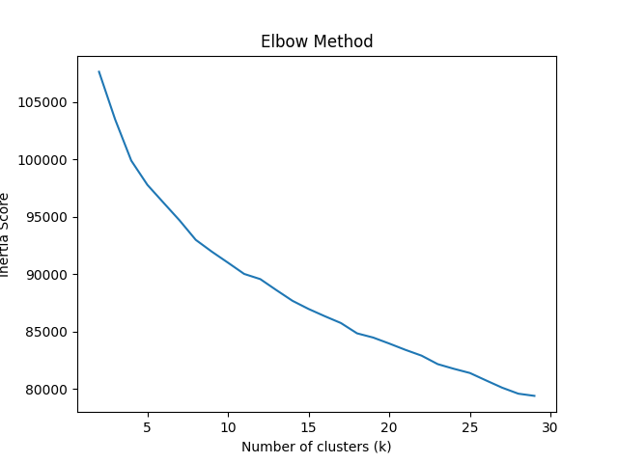
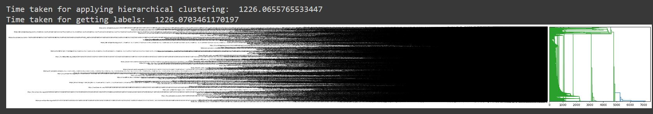
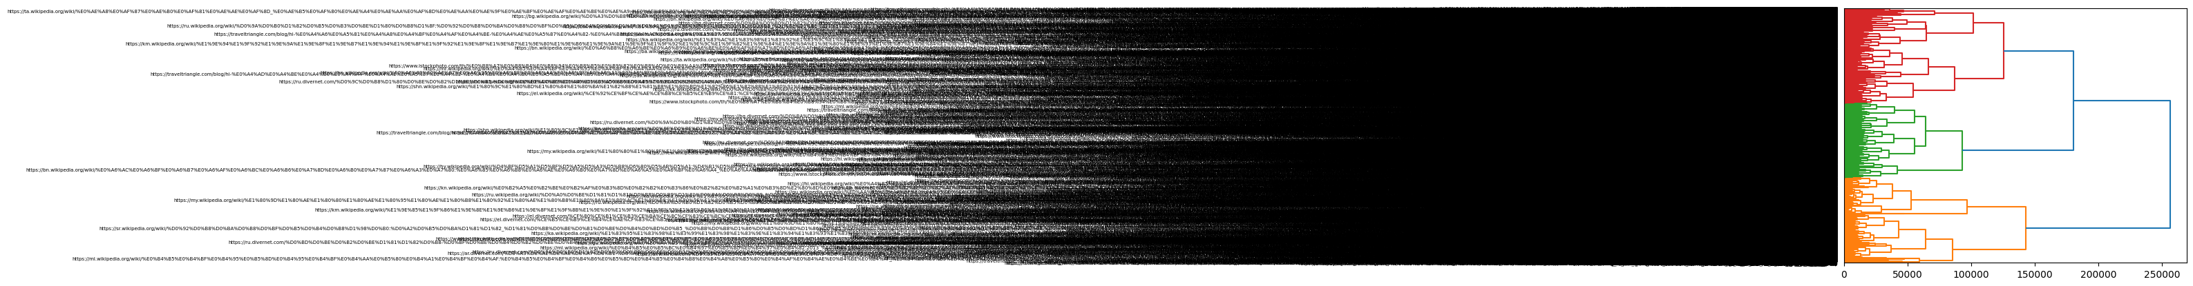
Clustering Snapshots (Shalin Kaji)

Slide 8
5. Query Expansion (Rashmitha Kalliot Yadav)
Implemented pseudo relevance feedback for query expansion
Association, Metric and Scalar clusters were implemented
Created vocabulary set, and local stems
Implementation was tested with 50 different queries.
It was observed that queries expanded by association cluster was faster.
Rocchio algorithm was implemented and tested on 20 queries

